Slide 1
Lecture 21
Realizing Existence as Co-existence
at All Levels

Slide 2
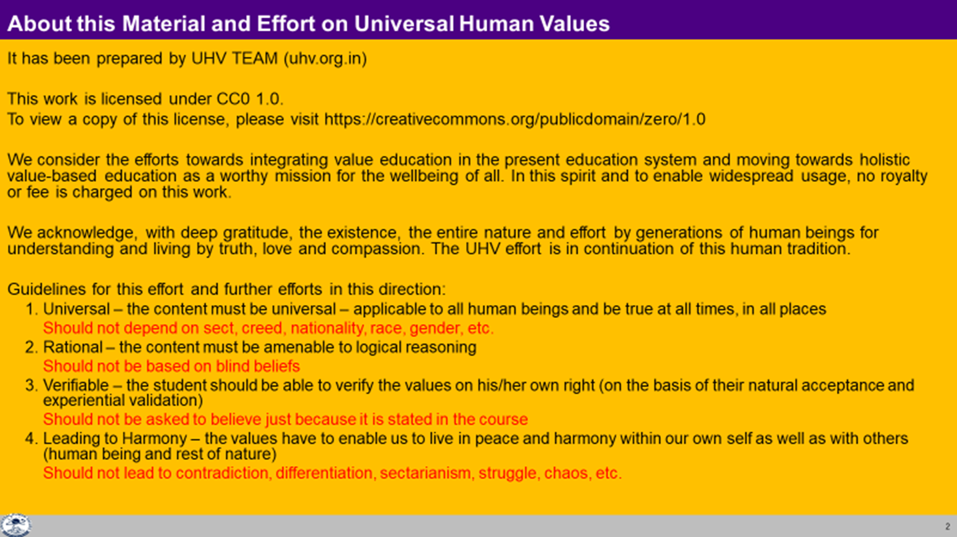

Slide 3
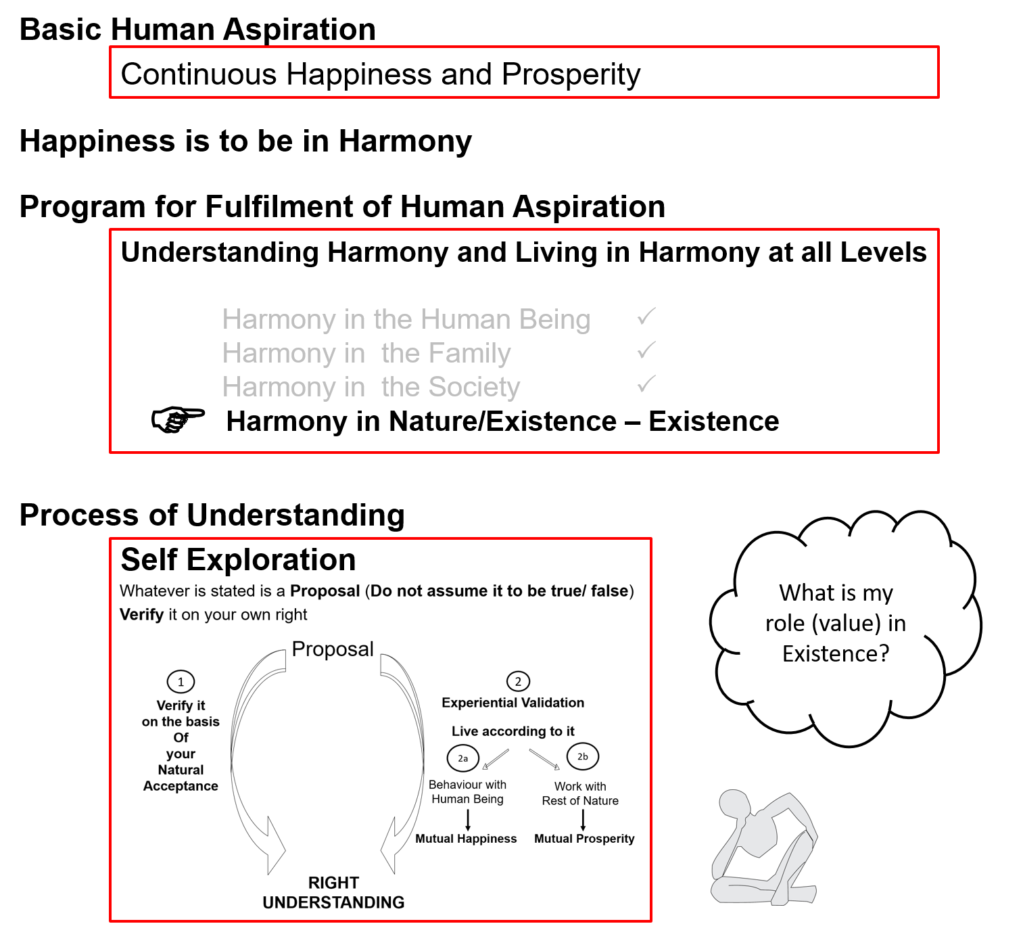

Slide 4
Harmony in Existence vfLrRo esa O;oLFkk
vfLrRo ¾ vfLr + + Ro
↓ ↓
gS@gksuk O;oLFkk
Existence = Exist + Essence
Whatever ↓ ↓
Exists is/to be harmony (mutual fulfillment)
vfLrRo ¾ lg&vfLrRo ¾ “kwU; esa lai`Dr bdkb;ka
Existence = Co- Existence = Units submerged in Space

Slide 5
Harmony in Existence vfLrRo esa O;oLFkk
A units can be identified by its boundary, limitedness
Units appear to be separate from each other, in isolation from each other
So, when we focus on units only, we see the isolation, the separateness, dividedness
Are they separate and isolated, unrelated or are they separate but related?
We have seen that they are related, then what is the basis of this relationship?
To understand this, we have to understand the reality which remains undivided in the these divided units- and that is Space,
So, in addition to the units, we need to understand the space also.
vfLrRo ¾ lg&vfLrRo ¾ “kwU; esa lai`Dr bdkb;ka
Existence = Co- Existence = Units submerged in Space

Slide 6
Harmony in Existence vfLrRo esa O;oLFkk
Existence vfLrRo =
Units Submerged in Space Ever Present
bdkb;ka lai`Dr “kwU;
Limited in Size lhfer vkdkj Unlimited vlhe
(All Pervading, O;kid)
Activity, Active fØ;k] fØ;k'khy No Activity fØ;k”kwU; ¼“kwU;½
  1. Energised in Space (“kwU; ds lg&vfLrRo esa ÅftZr gS)
  2. Self organised in Space (“kwU; ds lg&vfLrRo esa fu;af=r gS] Lo;a esa O;oLFkk gS)
  3. Recognises it's relationship,
  Fulfills its relationship with every other Unit in Space
  (“kwU; ds lg&vfLrRo esa ijLijrk dks igpkurh gS] fuokZg djrh gS
  cMh O;oLFkk esa Hkkxhnkj gS] lexz O;oLFkk esa Hkkxhnkj gS)
CO-EXISTENCE
lg&vfLrRo

Slide 7
Existence
Existence vfLrRo
Ever Present fuR; orZeku
Units Submerged in Space
bdkbZ;ka lai`Dr O;kid
Limited in Size lhfer vkdkj Unlimited vlhe All Pervading
Activity, Active fØ;k] fØ;k'khy No Activity fØ;k”kwU; ¼“kwU;½
Material tM+ Consciousness pSrU;
Recognising, Knowing, Assuming,
Fulfilling Recognising, Fulfilling
Ever
Temporary Continuous Unbounded in Time & Space
vfuR; fujarj fuR;
¾ Co-existence lg&vfLrRo

Slide 8
Existence
(= Co-existence = Units submerged in Space)
Units (Nature)
Space (All-pervading)
Limited in size
Unlimited
This is already in harmony
Activity, Active
No activity
Self-organized
Energized
Recognises the relationship and fulfills
Material tM+
Consciousness (Self) pSrU;
Temporary
Continuous
Recognising, Fulfilling
Knowing, Assuming, Recognising, Fulfilling
Physical Order
Bio Order
+
Animal Order
Atom
Cell
Only this part is remaining
And it has to happen in the Self by the Self
+
Molecule
Plant
Human Order
Molecular Structure
Animal Body
Right Understanding &
Right Feeling
Development
Linear – Not Cyclic
Lump
Fluid
Human Body
No Development
Cyclic
Definite Human Conduct
uf”pr Ekkuoh; vkpj.k

Slide 9
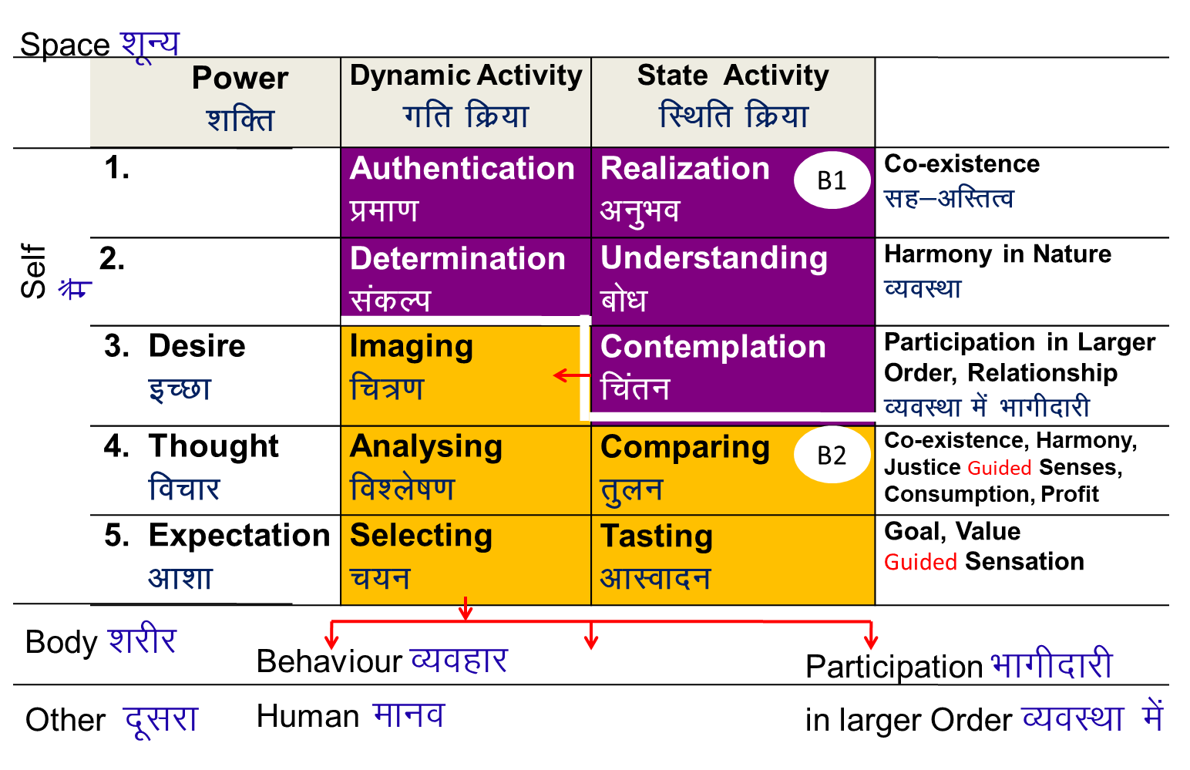
Existence
(= Co-existence = Units submerged in Space)
Universal Order
सार्वभौम व्यवस्था
Units (Nature)
Space (All-pervading)
Limited in size
Unlimited
Activity, Active
No activity
Self-organized
Energized
Recognises the relationship and fulfills
Material tM+
Consciousness pSrU;
(Self)
Temporary
Continuous
+
Recognising, Fulfilling
Knowing, Assuming, Recognising, Fulfilling
+
+
Animal Order
Human Order
Physical Order
Bio Order
Atom
Cell
Molecule
Plant
Development
Linear – Not Cyclic
Molecular Structure
Animal Body
Lump
Fluid
Human Body
No Development
Cyclic

Slide 10
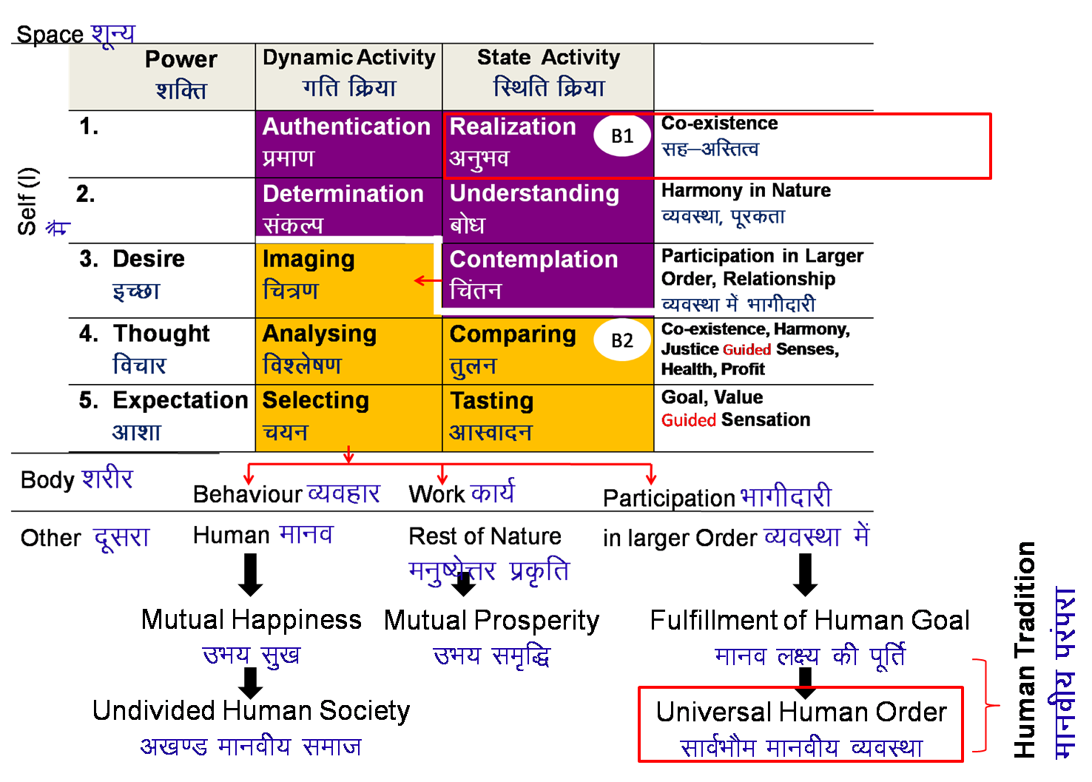
Existence
(= Co-existence = Units submerged in Space)
Units (Nature)
Space (All-pervading)
Limited in size
Unlimited
Activity
No activity
Self-organized
Energized
Recognises the relationship and fulfills
Material tM] xBu'khy
Consciousness pSrU;] xBuiw.kZ
Temporary
Continuous
Recognising, Fulfilling
Desh-Disha-Kaal
GEOGRAPHY (Desh, Disha)
HISTORY (Kaal)
+
Knowing, Assuming, Recognising, Fulfilling
+
Animal Order
Human Order
Physical Order
Bio Order
PHILOSOPHY (B1 correctly)
PHYSICS
CHEMISTRY
Atom
Cell
BOTANY
Molecule
Plant
DHARM NEETI (RIGHT UTILISATION)
PSYCHOLOGY (B2 now)
ZOOLOGY
MEDICAL SCIENCE
Molecular Structure
Animal Body
POLITICAL SCI
HISTORY
Lump
Fluid
Human Body
Composition – Decomposition
LakxBu&fo?kVu
Cyclic xBu'khy
MANAGEMENT
SOCIOLOGY
Development
Fodkl
No Cycle xBuiw.kZ
ECONOMICS
TECHNOLOGY

Slide 11
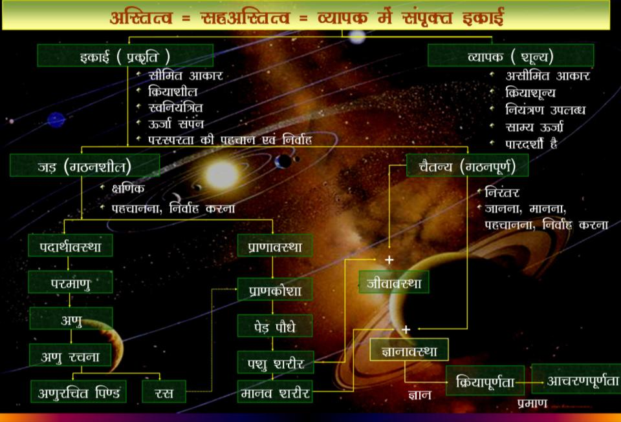

Slide 12
Sum Up
Existence is in the form of co-existence. It is ever present
(Existence = Co- Existence = Units submerged in Space)
Every unit in existence is related with every other unit in existence in a mutually fulfilling manner
Synergy is intrinsic to existence, harmony is inherent in existence – we do not have to create it, we do not have to construct it
The role of Human Being is to realize this co-existence, this harmony, this order in existence.
For this, all that human beings need to do is:
  To understand the inherent harmony, the co-existence in existence
  To live accordingly – to live with the feeling of harmony or co-existence (and there is every provision in existence for living in co-existence)

Slide 13
Self Reflection

Slide 14
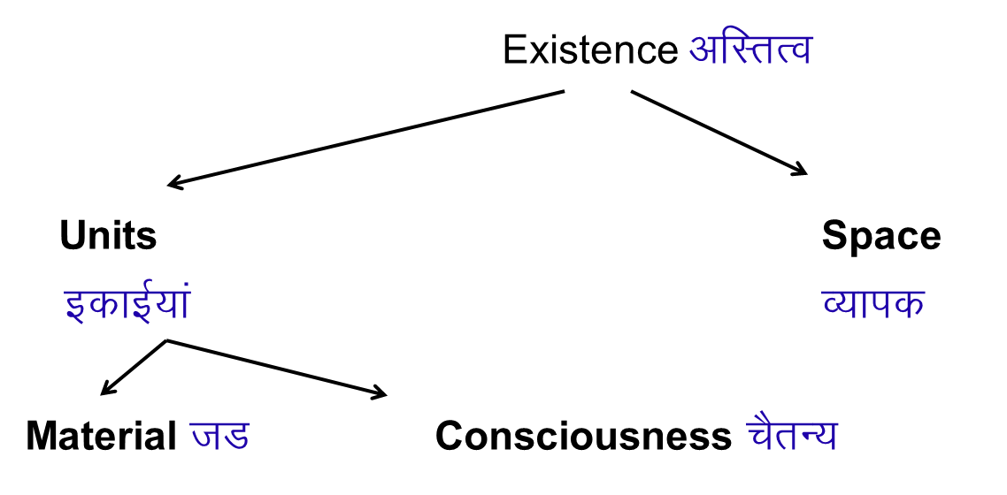
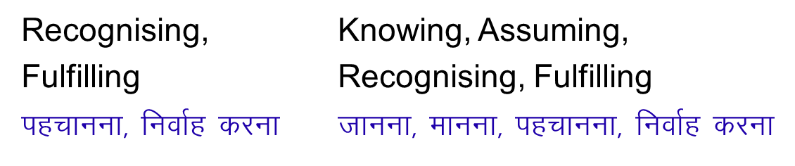
Practice: Material or Co-existence of Consciousness and Material?
Water
Human being
Mosquito
Dog
Parrot
Lizard
Mango tree
Grass
Moon
Assuming can be influenced
Can be trained
मानना को बदला जा सकता है

Slide 15
Self Reflection
Is Nature/Existence self organized or is it a chaos?
Is struggle inherent in Nature/Existence or is there co-existence?
Is there survival of the fittest in Nature/Existence or is there mutual fulfilment?
Have we recognised our self, our needs / goals correctly?

Slide 16
Key Points
Lecture 21: Realizing Existence as Co-existence at All Levels

Slide 17
Harmony in Existence vfLrRo esa O;oLFkk
Existence vfLrRo =
Units Submerged in Space Ever Present
bdkb;ka lai`Dr “kwU;
Limited in Size lhfer vkdkj Unlimited vlhe
(All Pervading, O;kid)
Activity, Active fØ;k] fØ;k'khy No Activity fØ;k”kwU; ¼“kwU;½
  1. Energised in Space (“kwU; ds lg&vfLrRo esa ÅftZr gS)
  2. Self organised in Space (“kwU; ds lg&vfLrRo esa fu;af=r gS] Lo;a esa O;oLFkk gS)
  3. Recognises it's relationship,
  Fulfills its relationship with every other Unit in Space
  (“kwU; ds lg&vfLrRo esa ijLijrk dks igpkurh gS] fuokZg djrh gS
  cMh O;oLFkk esa Hkkxhnkj gS] lexz O;oLFkk esa Hkkxhnkj gS)
CO-EXISTENCE
lg&vfLrRo

Slide 18
Existence
(= Co-existence = Units submerged in Space)
Units (Nature)
Space (All-pervading)
Limited in size
Unlimited
This is already in harmony
Activity
No activity
Self-organized
Energized
Recognises the relationship and fulfills
Material tM+
Consciousness (Self) pSrU;
Temporary
Continuous
Recognising, Fulfilling
Knowing, Assuming, Recognising, Fulfilling
Physical Order
Bio Order
+
Animal Order
Atom
Cell
Only this part is remaining
And it has to happen in the Self by the Self
+
Molecule
Plant
Human Order
Molecular Structure
Animal Body
Right Understanding &
Right Feeling
Development
Linear – Not Cyclic
Lump
Fluid
Human Body
No Development
Cyclic
Definite Human Conduct
uf”pr Ekkuoh; vkpj.k

Slide 19
Existence
(= Co-existence = Units submerged in Space)
Universal Order
सार्वभौम व्यवस्था
Units (Nature)
Space (All-pervading)
Limited in size
Unlimited
Activity, Active
No activity
Self-organized
Energized
Recognises the relationship and fulfills
Material tM+
Consciousness pSrU;
(Self)
Temporary
Continuous
+
Recognising, Fulfilling
Knowing, Assuming, Recognising, Fulfilling
+
+
Animal Order
Human Order
Physical Order
Bio Order
Atom
Cell
Molecule
Plant
Development
Linear – Not Cyclic
Molecular Structure
Animal Body
Lump
Fluid
Human Body
No Development
Cyclic

Slide 20
Sum Up
Existence is in the form of co-existence. It is ever present
(Existence = Co- Existence = Units submerged in Space)
Every unit in existence is related with every other unit in existence in a mutually fulfilling manner
Synergy is intrinsic to existence, harmony is inherent in existence – we do not have to create it, we do not have to construct it
The role of Human Being is to realize this co-existence, this harmony, this order in existence.
For this, all that human beings need to do is:
  To understand the inherent harmony, the co-existence in existence
  To live accordingly – to live with the feeling of harmony or co-existence (and there is every provision in existence for living in co-existence)

Slide 21
Gist
Lrj fLFkfr xfr .
vfLrRo lg& vfLrRo lkoZHkkSe O;oLFkk
Ekkuo vuqHko izek.k
ijLijrk esa izse] d:.kk v[k.M lekt
Level State Expression .
Existence Co-existence Universal Human Order
Human Being Realisation Evidence, Authentication
In Mutual relationship Love, Compassion Undivided Society

Slide 22
FAQs for Lecture 21
Realizing Existence as Co-existence at All Levels

Slide 23
Question(s): Units Response
What is fluid?
What is lump?
Fluid here is used to indicate the liquid that is used by the unit of bio-order for its nurturing; e.g. juice, water etc. are used by human being for nurturing his body.
Lump is gross aggregation of molecular structure or structures. For example, a rock, a log of wood, a piece of iron

Slide 24
Question(s): Space Response
Why is space being called ‘shoonya’ (nothing)? Is space = nothing? Nothingness?
Unit is activity, but, space is ‘no-activity’. space is ‘no-activity’, therefore, it is called ‘kriya-shoonya’ or in brief ‘shoonya’ . So, space is ‘no-activity’, it is not an activity, not a unit, not a thing. In that sense it is called as nothingness- what it means is that it is not a thing, not a unit, an activity. It does not mean that it is not a reality.
It is a reality but, it is not a thing,
it is not a unit
it is not an activity
no-thing (not nothing)

Slide 25
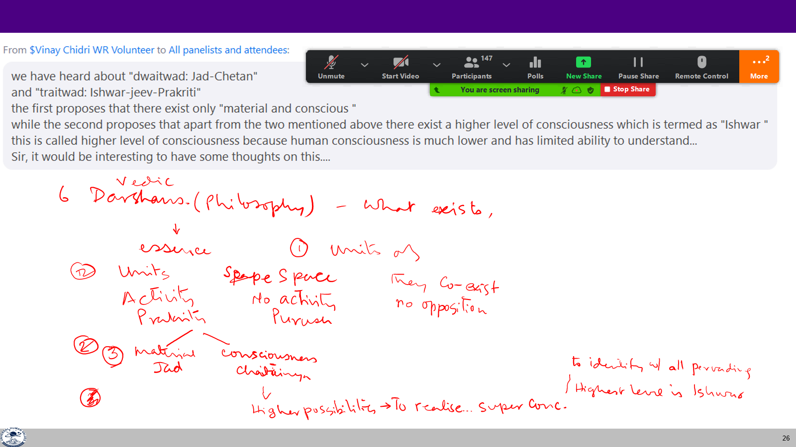
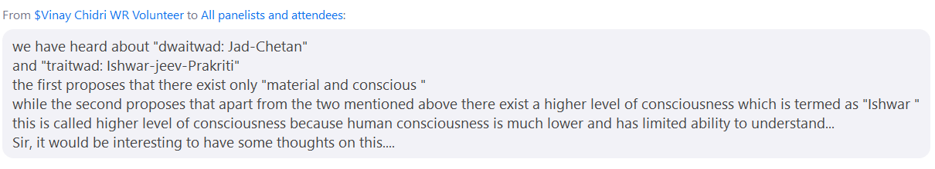

Slide 26
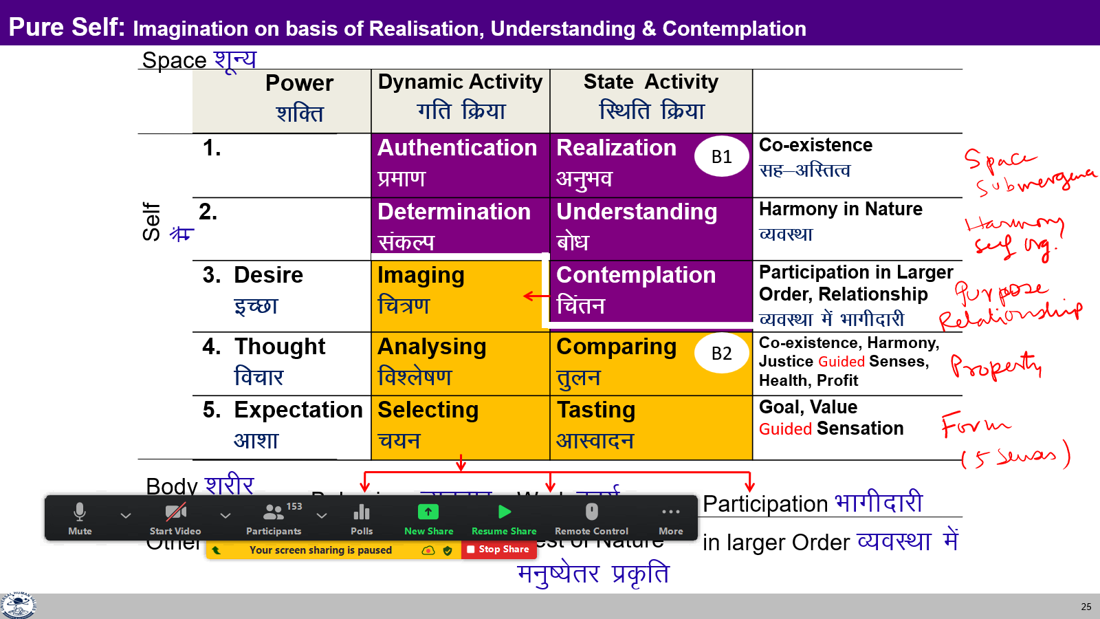
Question(s): Space Response
I am able to see the units, but not space. How to see the space?
Such questions are covered in UHV-III
before we respond to the question, let us try to understand what do we mean when we say “see”.
“see” means what the self is able to get about a particular reality. This certainly depends upon the level of activity of the self through which this seeing is done.
For example, when we are working at the level of selecting and tasting, then ‘seeing’ would mean what we are able to perceive through tasting, through 5 senses- sound, touch, sight, taste, smell; one of this being the form of the unit. So, seeing the form of an unit is just a part of the what we see through tasting, and this itself is part (one of the 5 levels) of activities of self.
...

Slide 27

To See
Form (u¹) = shape, size, density of unit¹
Property (u¹, u²) = effect of unit¹ on unit²
= recognition-fulfillment by unit¹ with unit²
Seeing through sensation Body + Self (I)
  Form (shape, size, density…) Eyes, ears…
  Some part of property (effect on other unit) Selecting-Tasting
Seeing what is rational Self (I)
  Some part of property (effect on other unit) Selecting-Tasting, Analysing-Comparing
Seeing what is existential (essence) Self (I)
  Natural Characteristic (participation in larger order) Contemplation
  Innateness (self organisation) Understanding
  Co-existence (submergence - of units in Space) Realisation

Slide 29
Details of the Four Orders
ORDERS 4 voLFkk | UNITS bdkbZ | ACTIVITY fØz;k | INNATENESS /kkj.kk (Self-organisation) | NATURAL CHARACTERISTIC LoHkko (Participation) | INHERITANCE vuq’kaxh;rk
Physical inkFkZ | Soil, Metal feV~Vh] /kkrq | Formation - Deformation jpuk&fojpuk | Existence vfLrRo | Composition-Decomposition LakxBu&fo?kVu | Constitution based Ikfj.kke vuq’kaxh
Pranic izk.k | Plants, Trees isM+] ikS/ks | "-“ + Respiration “olu&iz”olu | " + Growth iqf’V | " + Nurture-Worsen lkjd&ekjd | Seed based cht vuq’kaxh
Animal tho | Animals, Birds i”kq] i{kh | "-“, " in Body “kjhj esa Selecting/Tasting in I p;u@vkLoknu eSa esa | ", " in Body “kjhj esa Will to live in I eSa esa Tkhus dh vk”kk | ", " in body “kjhj esa Cruelty, Non-cruelty in I eSa esa Øwjrk] vØwjrk | Breed based oa”k vuq’kaxh
Human Kku | Human Beings euq’; | "-“, " in Body “kjhj esa Imaging, Analysing, Selecting/Tasting in I fp=.k] fo'ys’k.k] p;u@vkLoknu eSa esa Potential for Contemplation, Understanding & Realisation in I le>us dh {kerk eSa esa | ", " in Body “kjhj esa Will to live with continuous happiness in I eSa esa fujarj Lkq[kiwoZd Tkhus dh vk”kk Right Feeling & Thought lek/kku Right Understanding Kku | ", " in body “kjhj esa Perseverance, Bravity, Generosity… in I eSa esa /khjrk] ohjrk] mnkjrk]]] | Education-Sanskar based f”k{kk&laLdkj vuq’kaxh
Lo;a esa O;oLFkk
O;oLFkk esa Hkkxhnkjh
Next Generation
Human Education-sanskar

Slide 30
Nature = Collection of Units = 4 Orders
The presence of Self (I) is
indicated by
1. the presence
of the activity of Assuming
2. Developed part of the Body that can communicate with the Self – Brain
3. Can take signals from HB
To understand the other three orders, right understanding of the Human Order is required,
otherwise over-evaluation, under-evaluation or otherwise-evaluation of the other orders keeps taking place.
Recognizing, Fulfilling
Bio Order
Plants, Trees
izk.k voLFkk
isM+] ikS/ks
Assuming,
Recognizing, Fulfilling
Recognizing, Fulfilling
Physical Order
Soil, Metal
inkFkZ voLFkk
feV~Vh] /kkrq
Animal Order
Animals, Birds
tho voLFkk
i”kq+] i{kh
Self (I) +
Body
Human Order
Human Being
Kku voLFkk
euq’;
Assuming,
Recognizing, Fulfilling
Potential for Knowing, Assuming,
Recognizing, Fulfilling
Self (I) + Body

Slide 31
Question(s): Space Response
Why study something which has no activity?
Value is the participation in the larger order. So, what is the value of space? And if no value, then why to study it.
It is a reality (not something) which is ‘no activity’, but, in which every activity is taking place, through which every activity is related to every other activity, as discussed before.
Participation is defined wrt a unit, which is in the process of becoming, it has to participate in terms of certain activities at the level of this unit wrt to the activities in the other unit. When it comes to Space, it is complete in itself, it is not an activity, so, there is no process of becoming and hence, participation can not be defined in the sense we are talking about here. But, it is important to understand It as It is the base in which every activity is taking place, through which every activity is related to other activity.

Slide 32
Question(s): Space Response
Space is omnipresent. Is it omnipotent too? If it is a systematic unfolding, then isn’t the co-existence the doer also?
Space is all-pervading, therefore, it is said to be omnipresent.
As regard omnipotent, let us try to understand the followings –
Space is no-activity, therefore, it is not the one taking decision, in that sense it is not the “doer”.
But, all the activities are taking place in Space, in co-existence in Space, in that sense it is at the base of all activities, all that is happening in nature.
As proposed, all that we see in nature, is the systematic unfolding of co-existence, of units submerged in space; in this sense, co-existence is the basic cause, fundamental cause of all that we see in nature. However,

Slide 33
Question(s): Space Response
Space is omnipresent. Is it omnipotent too? If it is a systematic unfolding, then isn’t the co-existence the doer also?
…when we say doer, it involves taking a decision which is an activity of consciousness unit, which of course is an unit borne out of this process of unfolding of co-existence. So, the consciousness unit which is taking the decision is the doer.

Slide 34
Question(s): Submergence Response
All units are supposed to be activity. If you look at a stone there is nothing going on in it, then how is a stone activity? Also how is it active, because it is not moving or anything?
All unit are activity, activity is going on in every unit. However, it may be gross or subtle. Depending upon our capacity to see, we are able to observe these activities (as discussed before). If we seeing at the lower level of activities of the self, then we can only see the gross activities, but, as we start seeing from higher and higher activities of the self, we can see subtler and subtler activities taking place in nature. At the level of understanding, we can see the subtlest activity, and at the level of realisation, we can even see the space which is no activity.
Now, when we look at the stone through lowest level of activity that tasting through sight, we do not see gross activity and therefore we conclude that there is no activity.

Slide 35
Question(s): Submergence Response
All units are supposed to be activity. If you look at a stone there is nothing going on in it, then how is a stone activity? Also how is it active, because it is not moving or anything?
How can we say that unit is self-organized by virtue of co-existence?
…However, if we start analysing it, we can see that this stone is made of molecular structures binding together which itself is activity, further, these molecular structures themselves are activities and so on.
Let us look at earth, the earth is in space. It is self-organised in space, by the very design of co-existence, of units submerged in space. Is some one organising it? Similarly, look at an atom, the atom is in space, it is self-organised in space and it is recognising its relationship with other atoms and forming molecules. Now, are these atoms self-organised in space or someone is organising them?

Slide 36
Question(s): Submergence Response
How are units recognizing if they do not have a Self?
As we have studied, while discussing about human being, that material units have activity of recognizing and fulfilling while consciousness units have activity of knowing and assuming over and above recognizing and fulfilling. So, as far as recognizing and fulfilling is concerned, it is there I every unit, whether material or consciousness; only for knowing and assuming, we need to have a self, the consciousness unit.

Slide 37
Energy in Equilibrium (balance) Energy in non-equilibrium (relative)
No activity
Space
Energy is available to all (units)
All units are interrelated in space
Activity
Unit
Material Unit Conscious Unit
Interplay, exchange of energy
Recognises, fulfils relationship
Knowing, assuming
recognising, fulfilling
Min: primordial activity…
combining to form more and more complex activities (grosser)

Slide 38
Question(s): Energy Response
Earth gets energy from the Sun. So, how is it self-energized?
Earth is revolving around its axis, is it because of the sun? further, earth is revolving around sun, is it because of the sun? what we are proposing is that the earth is energized in space, so there are certain activities going on in the earth, similarly, the sun is energized in space, so there are certain activities going on in the sun, and with that there is some recognition and fulfillment in relationship between the two because of which, there are certain activities taking place. So, each one of them have to be understood separately and then together.
Let us now ask- where is the sun getting energy from? From fission reaction, then where is hydrogen atom getting energy from? Ultimately, we have to say that hydrogen atom is energised in space.

Slide 39
Question(s): Energy Response
The entropy of the universe is continuously increasing (second law of thermodynamics). That means it is leading to more and more disorderly state or chaos. How come we are saying existence is co-existence, is in harmony?
We need to reflect over this statement- “entropy of the universe is continuously increasing“. Does this apply to units belonging to all four orders or only to units belonging to physical order. For example, when a plant is assimilating food from soil and digesting it to make a part of it, is it getting more orderly or chaotic? Digested food becoming a part of the whole plant is certainly getting more organised, more in harmony with the plant then before; so, overall whether the orderliness, harmony is increasing or decreasing, this we have look deeper and try to understand. Now, when it comes to human being, what is naturally acceptable to us- harmony or disharmony, order or chaos? While going through the

Slide 40
Question(s): Energy Response
The entropy of the universe is continuously increasing (second law of thermodynamics). That means it is leading to more and more disorderly state or chaos. How come we are saying existence is co-existence, is in harmony? …continued
...process of understanding of harmony at all levels, we have seen that there is harmony at the level of first 3 orders, and human being has natural acceptance for being in harmony, and human being can also be in harmony by understanding the harmony in nature/ existence and living in harmony with it. So, the very design of nature/ existence is that of harmony, order and co-existence, not of disharmony, chaos and struggle. So, in the light of this, we have to relook at the the statement- entropy of the universe is continuously increasing.

Slide 41
Question(s): Time Response
What is time?
Time has to defined in respect of two different types of realities- one which is not changing with time, another which is changing with time. When we are talking with respect to reality which is not changing with time, then we can only say that it is ever present wrt to time. On the other hand, when we are talking with respect to reality which is changing with time, then we can talk about time wrt the change in that reality; for example, if the earth is revolving around the sun, we can define one revolution of earth around the sun as one unit of time- a year in this case, if a pendulum is oscillating, we can define one oscillation of pendulum as one unit of time- one second and so on .

Slide 42
Question(s): Time Response
There is impermanence? How is space ever present?
There is impermanence in the units of material as its form itself is changing. When it comes to unit of consciousness, its form (structure) is continuous in time. However, at the level of activities, there may still be some change. As far as activities of imagination is concerned, it may keep changing unless it is guided by the higher level of activities, particularly, the activity of realisation. So, There is permanence at the level of activity of realisation. Further, when it comes to space, it is no activity, therefore, there is no possibility of change anyway, hence, it is permanent in nature. In fact, space is invariant over both time and space.

Slide 43
Temporary, Continuous and Ever-Present
Existence vfLrRo
Ever Present fuR; orZeku
Units Submerged in Space
bdkbZ;ka lai`Dr O;kid
Limited in Size lhfer vkdkj Unlimited vlhe All Pervading
Activity, Active fØ;k] fØ;k'khy No Activity fØ;k”kwU; ¼“kwU;½
Material tM+ Consciousness pSrU;
Recognising, Knowing, Assuming,
Fulfilling Recognising, Fulfilling
Ever
Temporary Continuous Unbounded in Time & Space
vfuR; fujarj fuR;
¾ Co-existence lg&vfLrRo

Slide 44
Unchaning and Changing
Space is unchanging
World of consciousness
  Structure of the Self is not changing
  The highest activities of the Self is not changing
  The lower activities of the Self are changing (when they are not guided by the higher activities)
World of material is changing
+ primordial activity (mahat tatva) is unchanging

Slide 45
Question(s): Time Response
If everything is going to end anyway, why bother? Just enjoy and be merry!
Not everything is going to end! As explained, the unit of consciousness continues to be and depending on whether its lower activities are guided by realisation or not, it is in a state of harmony and happiness or contradiction and unhappiness. If we desire for happiness in continuity, we have to keep working on awakening to the activity of realisation and ensuring that lower activities are in line with it. That will be a state of joy, state of bliss, otherwise we suffer in the hope of joy..

Slide 46
Impermanence & Permanence (Ever Present)
Time Bounded Unbounded Unbounded
Size / space Limited Limited Unlimited
Material Consciousness Space
जड़ चैतन्य शून्य, व्यापक
Temporary Continuous Ever
अनित्य निरंतर नित्य
Activity Activity No Activity
क्रिया क्रिया क्रियाशून्य
Body Self (I) Space
Sensation
Physical Facility
Imparmanent "Permanent" Permanent
in time in time & space

Slide 47
Living in the Present Living in the Ever Present
Regret of Past
Fear of Future
Opposition for Present
Evaluating Past on the basis of co-existence (no regret)
Planning Future on the basis of co-existence (fearlessness)
Living Now on the basis of co-existence (mutual fulfillment with units)
We tend to recall past when the present is not engrossing and
- some happy event (to draw happiness) or
- there is some regret
We tend to think of the future when the present is not engrossing and
- we want to plan for the future course of action or
- when there is an apprehension / uncertainty about the future
We tend to to be engrossed in the present when
- we are in harmony within and
- making effort for harmony outside
We are not engrossed in the present when
- we are in dis-harmony within

Slide 48
Question(s): Sound, Vibration… Response
What is sound?
There are 5 senses in human being- sound, touch, sight, taste and smell (through ears, skin, eyes, tongue and nose). With respect to these 5 senses, we have categorised the external inputs into these 5 categories. So, sound is the activity (vibration) which is sensed by the ears. Later on, it is generalised for certain range of vibrations (described in terms of frequency and intensity).

Slide 49
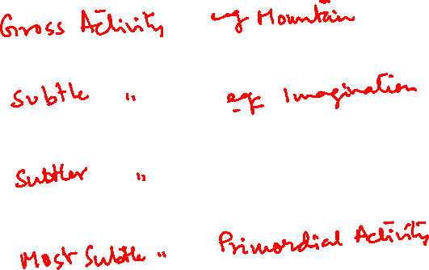
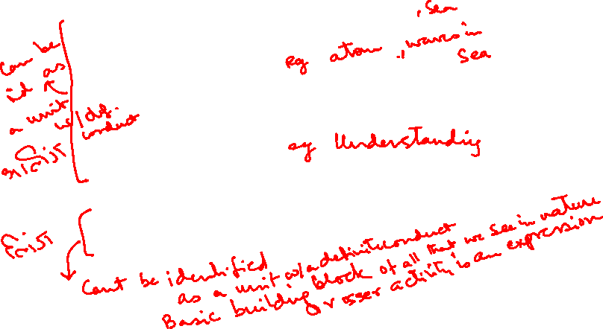
Question(s): Sound, Vibration… Response
They say that first there was sound… a primordial sound…
As we mentioned, there is whole range of activity ranging from very gross to very subtle. The subtle most activity which can be sensed by the self, (but, which can not be identified as definite unit) is called the primordial activity and the sound of this activity is called primordial sound. This primordial activity in space forms the basic building block for all the grosser activities, ultimately all the units in nature, in existence.

Slide 50
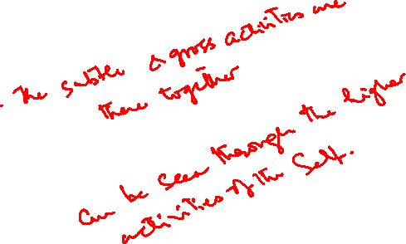
Question(s): Creation Response
How did it all start? There is a theory of the Big Bang regarding creation.
One of the thesis is that this primordial activity in space forms the basic building block for all the grosser activities, ultimately all the units in nature, in existence. This co-existence of primordial activity in all-pervading space expresses itself in the form of grosser and grosser activities and all that we see in nature is the natural unfolding of this co-existence. One interesting thing about this thesis is that all the gross and the subtle activities are existing together and we can see them depending upon our level of activities of the self as mention before.

Slide 51
Question(s): Creation Response
This existence is so big… unlimited and human being is so small. So how can we understand the whole existence?
Existence is big no doubt, but in essence it is units submerged in space, which can be realised by the self, further, units are of two types, material and consciousness, and they can be understood. Similarly all the units in nature can classified in terms of four order and they can be understood by human being. But, this is so for the essence; as far as description is concerned, that seems to be endless but, we can learn about the necessary details as and when required.

Slide 52
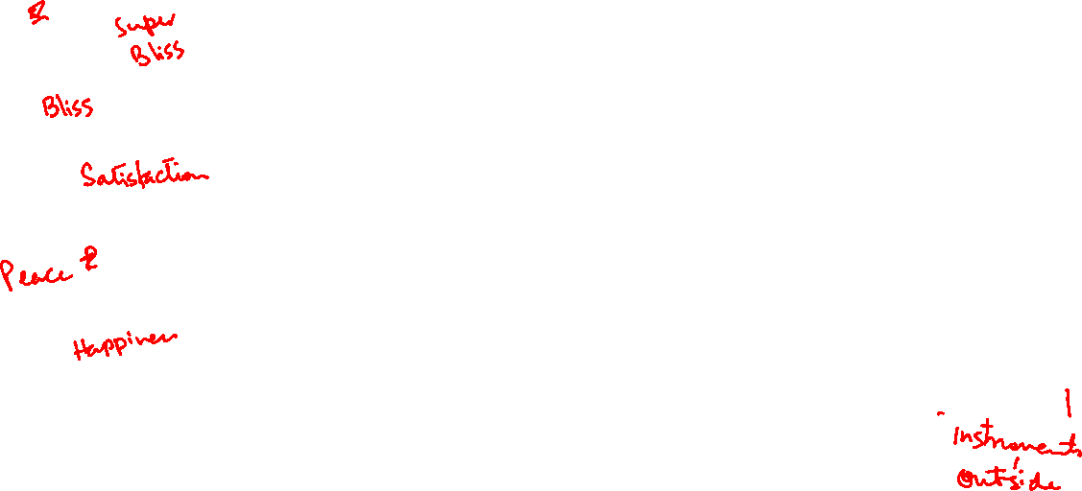

Slide 53
Question(s): God Response
In all this, so far there is no mention of God. What is God, according to you?
There are two major notions of God.
One is God (with a big G)
= Space, the all pervading
(all pervading, but no activity, not a doer)
god (with a small g) i.e. god
= a Self with the right understanding and right feeling; a realized Self
It is a unit and not all pervading.
This god, as a realised self, can be source of inspiration for us

Slide 54
Question(s): Response
Once a person dies, what happens to the Self?
What we can explore presently is that when we are there as human being, what is the status of the self and the body. Does the being of the self dependent on the body or the being of the self is there not depending on the activities of the body? Let us look at the activities of the self, like thought, we always keep thinking, whether we are interacting with body or not, even when we are not reading any sensation from the body or giving any instruction to the body, thinking goes on. When the body falls sick, activity of thinking does no go down. So, activities of the self is not dependent on the activities of the body.

Slide 55
Question(s): Response
Bondage?
Salvation?
Swatantrata?
To live with sorrow.
ca/ku & nq[k iwoZd thukA
Freedom from sorrow.
eks{k & nq[k ls eqfäA
To live with continuous happiness.
Lora=rk & fujarj lq[kiwoZd thukA

Slide 56
Question(s): Response

Slide 57
Ishwar (Space) bZ”oj ¼”kwU;½
is no activity, is not the doer fØ;k”kwU; gS] drkZ ughaA
is constant energy, is not omnipotent lkE; ÅtkZ gS] loZ”kfäeku ughaA
is reflecting, transparent, is not the knower. It is the ‘I’ who can know/ who knows. ikjn”khZ gS] Kkrk ugha gSA eSa Kkrk gSA
has self-organization available, is not the organizer or controller. “kwU; esa fu;a=.k miyC/k gS] fu;ark ugha gSA
is the basis of Atma to know the entire existence, in this sense it is Paramatma. “kwU; vfLrRo Kku ds fy, vkRek dk vk/kkj gS] bl vFkZ esa ijekRek gSA

Slide 58
Question(s): Response
How do you define theist and atheist
As I see it , theist is one who knows what exists and accepts, and atheist is one who assumes without knowing what doesn’t exist.

Slide 59
Last Slide

